Slide 1

ISASP Training:
Accessing Reports
Illustration by Lucy Vigrass
ISASP Reports Training
1
Notes:
Welcome to the Iowa Statewide Assessment of Student Progress Reports Training, Accessing Reports.
The purpose of this training is to outline the available reports, how to access reports and the printing and ordering of reports.

Slide 2

Agenda
Illustration by Kanae Sato
Published Report Types
Accessing Reports
Printing Reports
Ordering Printed Reports
ISASP Reports Training
Notes:
The following is a high level overview of this training. We will first begin by reviewing samples of the types of reports available. Next we will review who has access to the reports and after, we will provide more information regarding accessing reports in PearsonAccessNext, printing reports and requesting printed reports. To conclude we will provide contact information for Pearson Help Desk to contact with additional questions.

Slide 3
Published Report Types
Notes:
First we will begin this training by discussing the types of reports available in PearsonAccessNext for the ISASP Spring 2019 administration.

Slide 4
Published Report Types
Individual Student Report
Student Roster
Achievement Level Summary
PDF of a student’s scores and achievement level in the subjects taken.
PDF of all student scores at a school grouped by grade, subject and performance level.
PDF chart comparing the percentage of students at each achievement level at a school compared to both the district and the state averages.
Notes:
There are three types of reports available for ISASP Spring 2019.
The types of reports available are published reports named individual student reports, student rosters and achievement level summaries. These published reports are in PDF form and should be utilized to help delineate and understand student scores. Published reports are static or unchanging reports that are posted once a year after the close of each administration.
All reports are located in PearsonAccessNext via the published reports tab.
The first report is the individual student report. The purpose of the individual student report is to provide information regarding the student’s score and whether the student placed in the advance, proficient or not yet proficient level as established in conjunction with the Iowa State Board of Education, Iowa Testing Programs and Iowa teachers.
The second report available is the Student Roster. The purpose of the student roster is to group all students in a school by class, subject and grade and achievement level.
Lastly, the purpose of the achievement level summary is to provide more information regarding the breakdown achievement levels by school in comparison to both the district and the state.

Slide 5
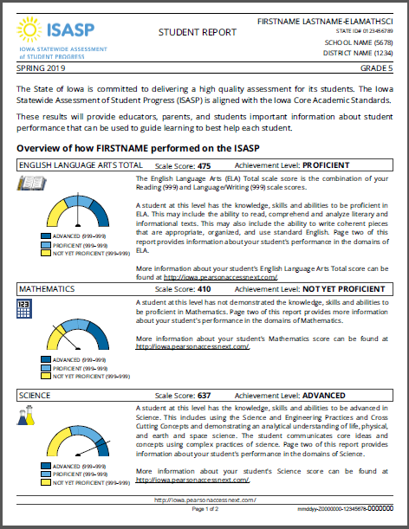
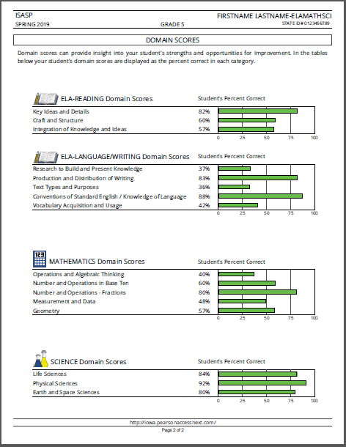
Published Reports - Individual Student Report
Notes:
The following is an example of the Individual Student Report.
The individual student report or ISR is a 2 page report that provides an overview of how a student scored based off of achievement level and the percentage of correct answers in each domain. The first page of this report provides the student’s scale score and corresponding achievement level for that scale score. Additionally the cut scores will be provided on the left-hand side of the first page of the report with a chart that shows where the student falls within that achievement level.
The second page of the report outlines how a student scored in each domain, listing the percentage the student answered correctly in the domain for each subject. Please note that the domain scores do not directly correlate to a student’s achievement level. For example, the domain scores should not be averaged to determine whether the student should be in an advance, proficient, or not proficient achievement level.
The individual student report is only available at the school level in PearsonAccessNext as opposed to the the district level. This means that District Coordinators must ensure the filters have been toggled to ensure access to all school and district reports. More on accessing reports will be available later in this presentation.
The ISR should be provided to parents as a means of sharing student results.Please be aware that you will only receive an ISR for the subject or subjects the student completed at your school. As a result, for transfer students, the student’s previous school must be contacted to obtain student scores.
Next, we will be discussing the student roster.

Slide 6
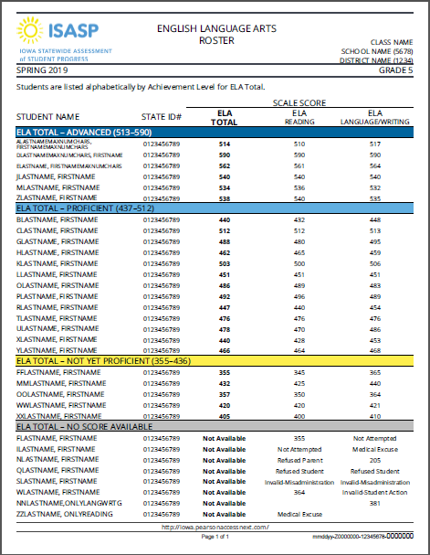
Published Reports - Roster
Notes:
The following is an example of a student roster.
The purpose of the student roster is to report all students at a given school by class, grade, subject, and achievement level. This report is grouped alphabetically first by class, grade and subject and then alphabetically by achievement level. The class name listed on the Student Roster is the class name listed in Pearson Access Next. If no class name was listed, the roster will default and group the students by grade. The cut scores are also outlined in the student rosters on the left-hand side of the page corresponding with each achievement level.
Next we will be discussing the Achievement Level Summaries.

Slide 7
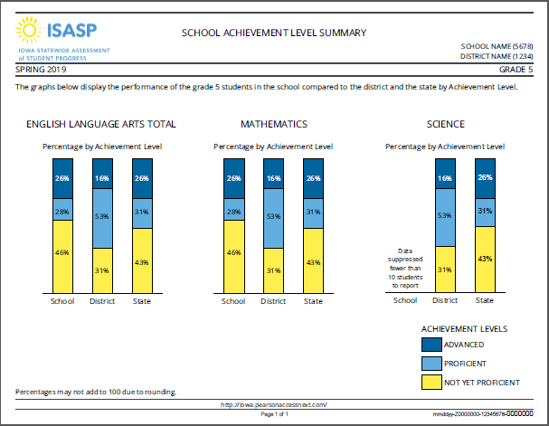
School Achievement Level Summary
Notes:
The following is an example of the School Achievement Level Summary.
The School Achievement Level summary shows the percentage of students at your school, district and state at each achievement level. This report should be used to compare how your school compares to the state and the district. This report is only available at the school level.
As you can see on this sample report, the sample school had 26% of students in the proficient level for English Language Arts, 53% at the district level compared to the state average of 31%. Unfortunately, if your school has fewer than 10 students to report the averages will not populate.

Slide 8
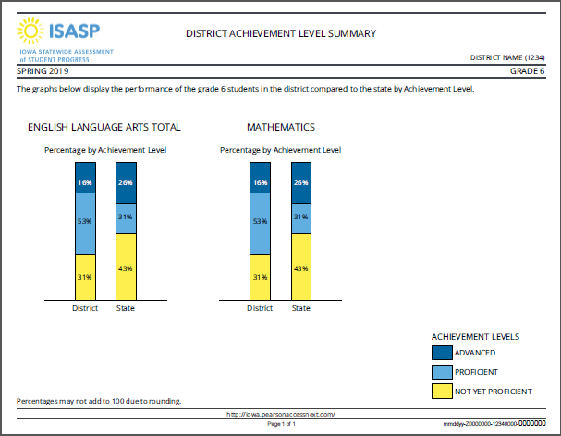
District Achievement Level Summary
Notes:
The following is an example of the District Achievement Level Summary.
The District Achievement Level summary is similar to the School Achievement Level summary as shows the percentage of students at your district and state at each achievement level. This report should be used to compare how your district compares to the state. This report is only available at the district level to District Coordinators in PearsonAccessNext.

Slide 9
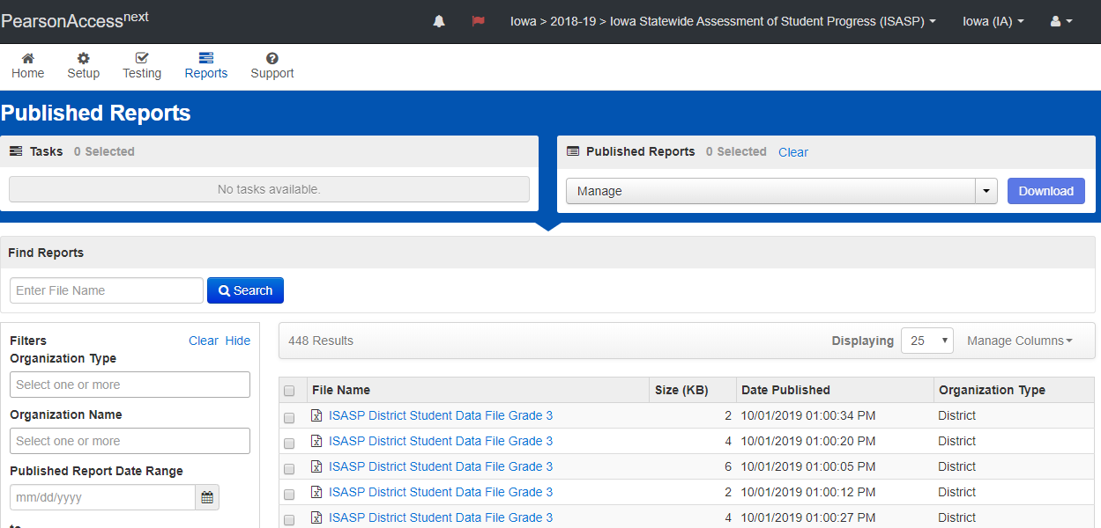
Published Reports - Student Data File
Notes:
The last report available in PearsonAccessNext is the Student Data File.
The student data file is an excel file with all student scores at the district. District Coordinators are the only user role that has access to this report. This report contains all student raw scores, scale scores, domain scores and demographic information at the district. This can be used to upload student data into your schools reporting system. The Student Data File is available to download in a CSV file. For more information regarding the column headings in the student data file, please see the student data file layout located on the Reporting Resources Tab of the ISASP Portal.

Slide 10
Accessing Reports
Notes:
Next, we will be discussing how District and School Coordinators can Access Reports in PearsonAccessNext.

Slide 11
Published Report Access by User Role
Student Report
Student Roster
Achievement Level Summary
District Coordinator
School Coordinator
District Coordinator
School Coordinator
District Coordinator - District and School Level
School Coordinator - School Level
Notes:
There are several user roles in PearsonAccessNext. User roles in PearsonAccessNext will have different views and access based off of the user role type. Not all users in PearsonAccessNext have access to all reports. The District Coordinator has access to all reports at both the district and school level. In comparison, the school coordinator will only have access to the reports at their given school. For example the district coordinator can toggle between the various schools in their district to access the school level reports, but will also have access to the reports that are only available at the district level such as the District achievement Level Summary. In comparison, school coordinators will only have access to the reports for the schools that are listed under their username in PearsonAccessNext, they will not have access to reports at schools they are not assigned to.
Additionally, Teacher and Proctor roles will not have access to any published reports. It is the responsibility of the district and school coordinators to provide Teachers with printed versions of the reports.
Next, we will discuss a little more in depth regarding navigating each report in PearsonAccessNext.

Slide 12
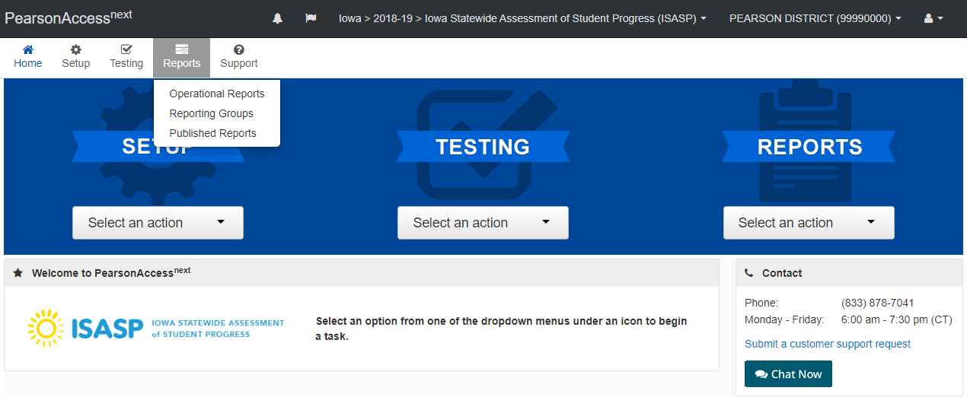
Accessing Published Reports
Notes:
All reports are to be accessed in PearsonAccessNext by district and school coordinators. When accessing reports and other functions, ensure the correct administration is selected at the top of the screen. To access the reports from Spring 19 the 2018-2019 administration must be selected, then select Reports and Published Reports. As a reminder, teacher and proctor roles will not have access to reports in PearsonAccessNext.

Slide 13
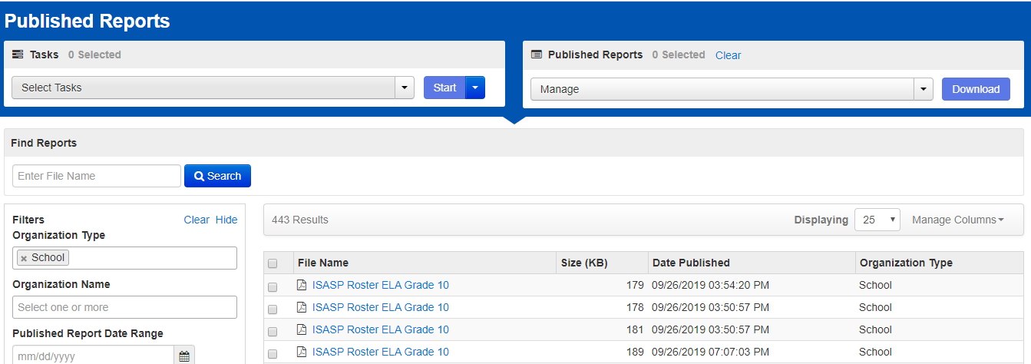
Accessing Published Reports
Notes:
The following is an example of the Published Reports page in PearsonAccessNext. All available reports are listed on this page. If a report is not showing, such as the ISR, please ensure the filters on the left hand side of the page are adjusted. Remember the same reports available at the district level will not also be available the school level. For example, as you can see on this page, the filters on the left side of the page under Organization type have been updated to allow access to School reports, such as the Rosters you see here.

Slide 14
Printing Reports
Notes:
Printing of reports is also completed in PearsonAccessNext.

Slide 15
Printing Reports in PearsonAccess^{next}
Notes:
To print reports, select the checkbox by the reports that you wish to print and select the download button on the top right hand side of the screen. Once the reports are downloaded they can be printed using the print function on your computer.
Alternatively, the blue file name for each report can be selected to download the pdf of that specific report.
All reports that are available will be listed on the Published Reports page. If a report is not showing, such as the ISR, please ensure the filters are adjusted on the left-hand side of the page. Remember different reports are available at the district and school levels.
Please be aware that printed reports will not be automatically shipped to districts and schools. Reports can either be printed in PearsonAccessNext or a printed version of the reports can be requested. Next we will be discussing how to request printed reports in PearsonAccessNext.

Slide 16
Ordering printed versions of ISRs and Rosters

Slide 17
Ordering Reports
Types of reports available and Costs (Invoiced by Iowa Testing Programs)
  Individual Student Reports - $0.60 per each student
  Student Rosters by grade/subject - $0.25 per each report
Ordering Reports
  School Coordinators can request reports
  District Coordinators can request and order reports
    Reports can only be ordered once
  Ordering Window
    November 4th, 2019 - December 9, 2019
    January 6, 2020 - February 28, 2020
Receiving Reports
  Reports will be delivered within 7-10 business day
Notes:
All published reports are available to be printed in PearsonAccess^{next}. However, ISRs and Student Rosters can be requested to be printed by Pearson. The cost for this service is $.60 cents per each ISR and 25 cents for each student roster.
ISR are a two page report and the cost is per student. However, when requesting printed versions of the ISR the request is made by grade. For example, if there are 50 students at a school in grade 3, the cost for the printed version of the ISR for that grade is $30. Ordering of reports for individual students is not available, but can be printed locally via PearsonAccessNext.
The printed version of the student rosters are requested by school, grade and subject. For example, if a school is requesting Student Rosters for grade 3 ELA and there are 4 Rosters or Classes listed, the cost for the Student Rosters for that grade will be $1.
School coordinators can request reports in PearsonAccesNext, however only District Coordinators are able order these reports. Reports can only be ordered once per district so once the order is submitted, it cannot be edited and additional reports can not be requested.
Reports will be available to order starting November 4th through December 9th and January 6th, 2020 to February 28th 2020 to accommodate school breaks.
School coordinators must verify with their district, the district deadline for ordering materials.
One copy of each report ordered will be delivered within 7-10 business days after the order was placed.

Slide 18
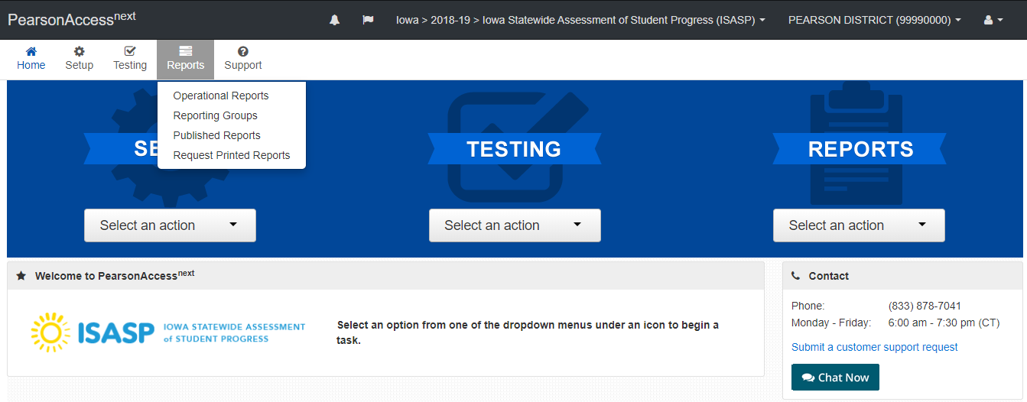
Ordering Reports
Notes:
To order printed reports in PearsonAccessNext select reports and Request printed reports.

Slide 19
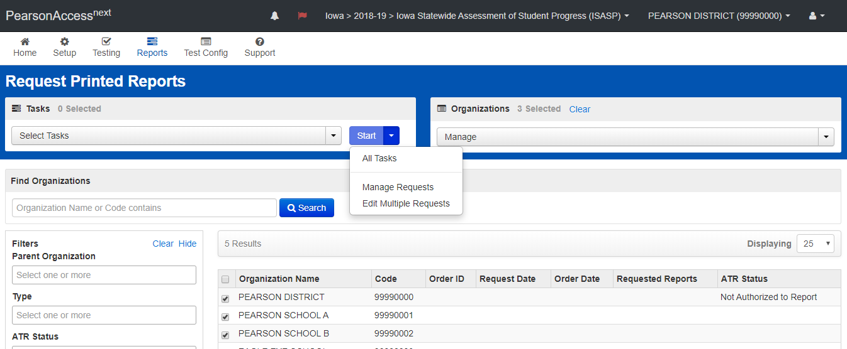
Ordering Reports
Notes:
Next, Coordinators can select the school or schools they would like to order printed reports for and select Start>All Tasks.

Slide 20
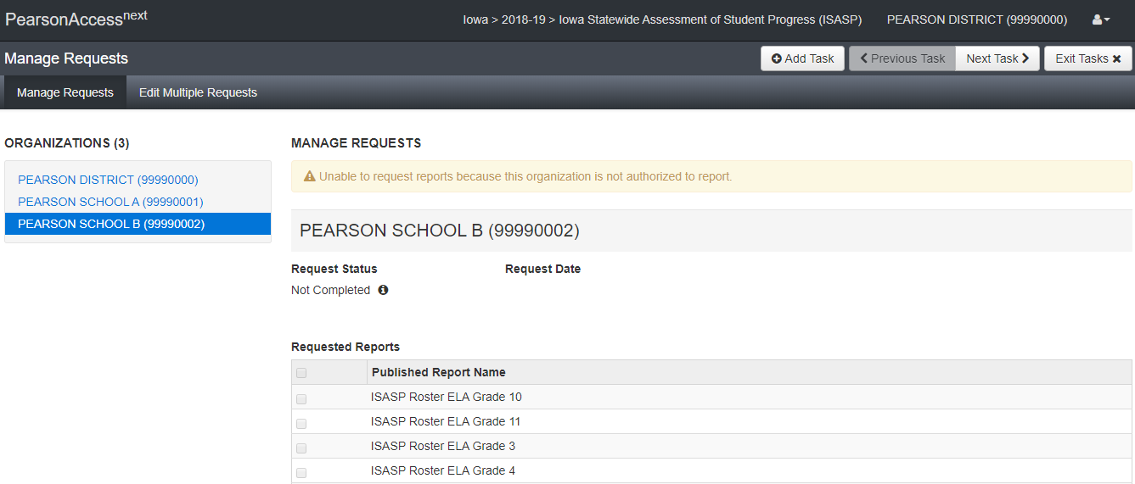
Ordering Reports
Notes:
The Manage requests tab allows for school and district coordinators to request the types of reports to be printed. To select the report toggle between schools, select the reports to be printed and select save at the bottom of the screen.

Slide 21
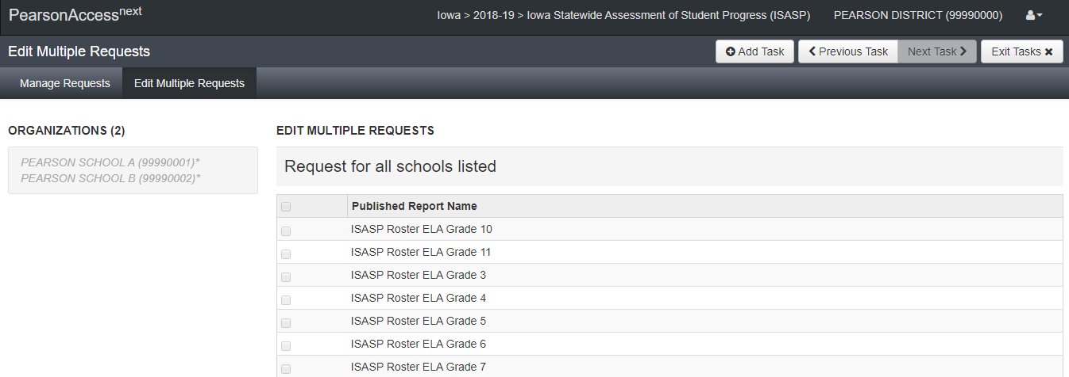
Ordering Reports
Notes:
A coordinator that has access to multiple schools or a district coordinator can select multiple schools and select the same reports for all schools listed and select save.
The Edit Multiple Requests tab allows coordinators with multiple schools to select the same reports for each school.
Please note that the edit multiple requests will only request reports for the schools listed on the left hand side of the page, if additional schools need to be added the exit tasks button can be selected to go back to the Request Printed Reports page.

Slide 22
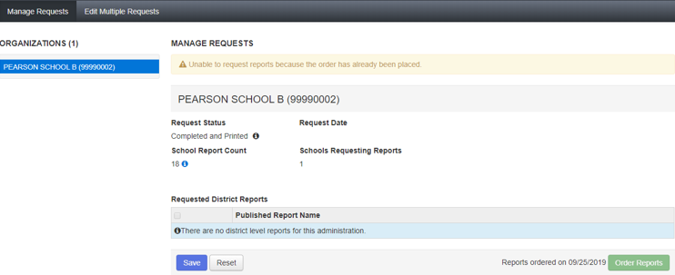
Ordering Reports - Order Placed
Notes:
Once all report requests have been submitted, a district coordinator can order the requested reports at the district level. The order reports function is only available at the district level on the Manage Requests tab.
Reports can only be ordered once so it is important that all requests have been submitted before proceeding with the order request.
If the order has already been submitted a warning will state “unable to request reports because the order has already been placed”. The bottom of the page will also state when the report request was submitted.

Slide 23
Pearson Help Desk
833-878-7041
http://iowa.pearsonaccessnext.com/support/
Monday – Friday, 6:00 am – 7:30 pm (CT)
Notes:
If you have any additional questions on accessing reports, the Pearson help desk can be reached at 833-878-7041 or by submitting a support request on the Support page of the ISASP Portal.
The Pearson Help Desk is open Monday-Friday from 6am - 7:30pm. Thank you for viewing the ISASP training for accessing reports

