Slide 1
ISASP 2026 Remote Testing Informational Webinar
March 25, 2026
ISASP Information From Iowa Testing Programs

Slide 2

Good afternoon and welcome – from ITP staff

Slide 3

Today’s Topics
Iowa House File 190
Remote Testing Window
Family Remote Testing Agreement Form
Remote Testing Practice Sessions In Training Site PearsonAccess^{next} (Live Demo)
Q&A Session

Slide 4
Iowa House File 190
Iowa House File 190, approved on June 11, 2025
“… any school district, accredited nonpublic school, or charter school providing instruction delivered primarily over the internet pursuant to subsection 32 may administer any state assessment required pursuant to this subsection in an online setting that is similar to the student's regular academic instruction …”

Slide 5
Notable Requirements From HF190
The student participates in a synchronous assessment session that is initiated and managed by personnel designated by the school district, accredited nonpublic school, or charter school.
The student takes the assessment using a device and an assessment platform that allow an assessment proctor to monitor the student for the duration of the assessment through a video feed that allows the assessment proctor to view the student taking the assessment and the student's background.
The school district, accredited nonpublic school, or charter school maintains a ratio of students taking the assessment to assessment proctors of not greater than ten to one.

Slide 6

ISASP 2026 Remote Testing Window
Start Date: 7:00 a.m. Monday, April 20, 2026
End Date: 5:00 p.m. Friday, May 8, 2026
Approved online schools set their own local window within these dates (or can set their local window for the full remote testing window)

Slide 7
Family Remote Testing Agreement Form

Slide 8
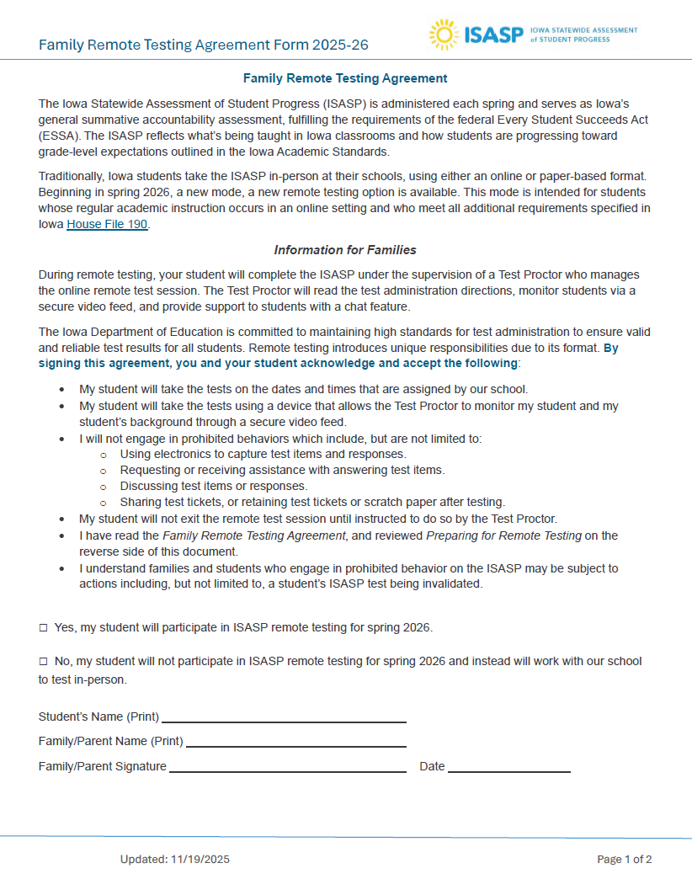
Form must be completed and returned to your school for each student testing remotely
Page 1 provides the background and key details about remote testing
  Section at the bottom for students’ families to complete and return to your school
It is vital families review, complete, and return the form:
  Families need to be aware of their unique responsibilities and requirements for remote testing
  Schools have a source to refer families to if questions come up
  Iowa Department of Education will ask to see completed forms during monitoring

Slide 9
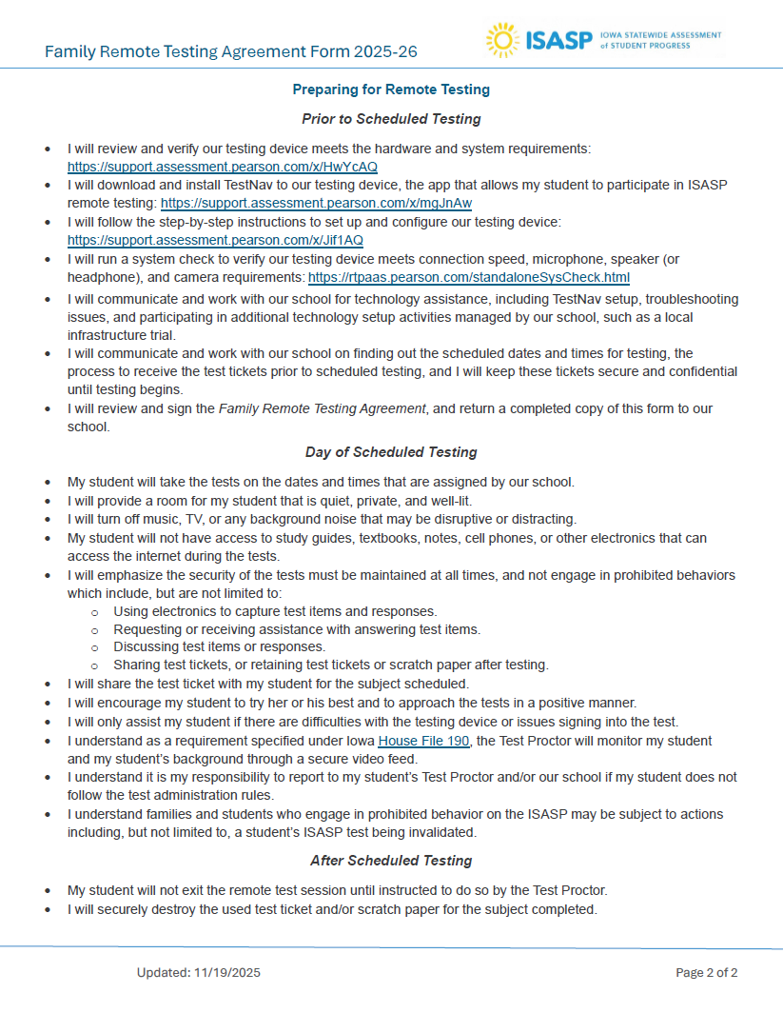
Schools determine the best way to share and receive completed family agreements (e.g., Google Forms)
Page 2 provides detailed preparation steps and requirements for a favorable and secure test-taking experience for the student
Note families must work with your school for technology assistance, including TestNav setup, troubleshooting issues, and any additional activities (e.g., remote testing practice sessions) – they should not reach out to Pearson
Also, families must check with your school for the local scheduled dates and times for remote testing and the process to receive testing tickets prior to the scheduled dates and times

Slide 10
Remote Testing Practice Sessions In Training Site PearsonAccess^{next}

Slide 11

Session Setup – Lessons Learned From Spring 2021
37,377 ISASP tests were taken remotely in 2021
  Did not run in the secure TestNav environment
  Proctors utilized a separate application to administer and communicate with students during this remote testing (Zoom, Google Meet, Microsoft Teams)
Lessons learned:
  Special remote testing forms had to be assigned manually for all remote sessions – many schools were inconsistent in doing this
  Schools did not have a standardized way of naming their remote sessions (“remote”, “virtual”, “online”)

Slide 12
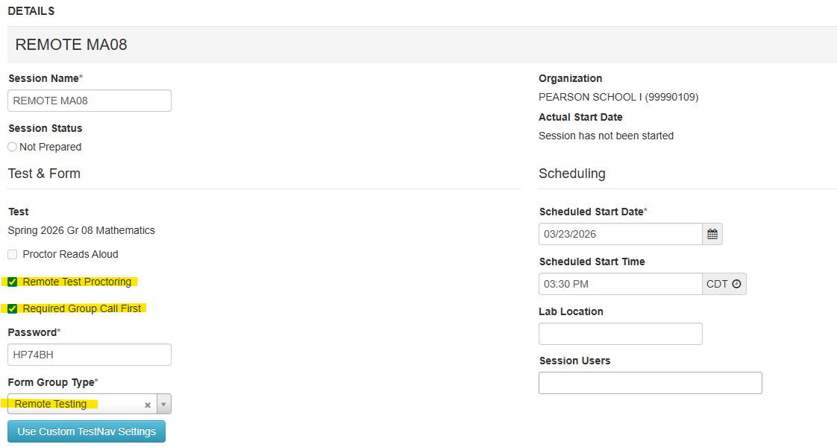
ITP will manually assign the special remote testing forms and enable remote settings for ALL remote sessions for online schools.
Special Remote Testing Forms And Settings

Slide 13
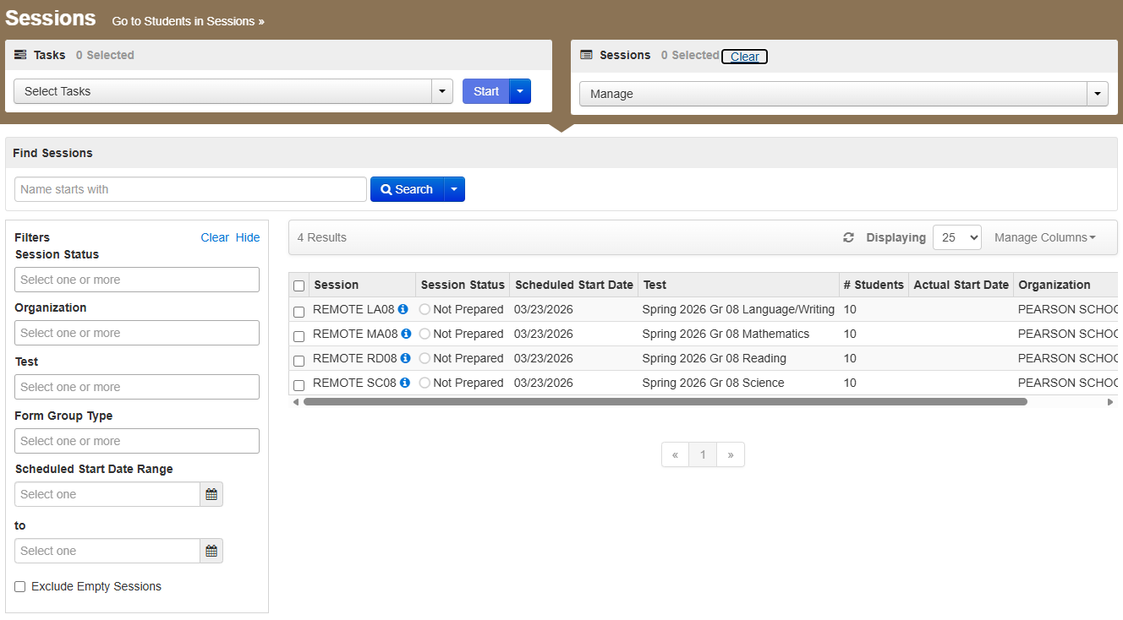
Naming Your Remote Sessions
For ITP to know which sessions are intended remote sessions, there needs to be a standardized naming convention all online schools must use:
For your remote sessions, put the word “REMOTE” at the beginning of your session name.

Slide 14

Your Remote Testing Practice Sessions
Email was sent on March 9, 2026, about remote testing practice sessions being available for online schools to try out with three attached guides:
  ISASP User Guide_Remote Practice Sessions in PearsonAccess^{next}
  ISASP User Guide_Remote Session - Monitor Test Screen
  ISASP User Guide_Students Screen During Remote Testing
Available in the training site PearsonAccess^{next}
Intended to emulate the live remote testing experience
  Requires TestNav installed on supported devices
  Must enter testing ticket username and password on the TestNav sign in screen
This is the best resource for Coordinators, Proctors, and students to experience the remote testing environment and prepare for the live test.

Slide 15
Timeline Of Next Steps For Schools
Event | Date
Schools share the Family Remote Testing Agreement Form with students and families, receive completed forms | Now – April 17, 2026
Coordinators and Proctors try out the remote testing practice sessions in training site PearsonAccess^{next} | Now – April 6, 2026
Schools work with students and families to ensure TestNav is installed and technology issues are resolved, strongly recommended to have students try signing in to the remote testing practice sessions Pearson technology office hours is a resource available to schools (not students and families) to resolve technology issues | April 6–17, 2026
Coordinators review their student roster in live PearsonAccess^{next}, assign accommodations (if needed), and create remote sessions (live testing tickets become available once sessions are created and students added) Schools determine how to share testing tickets with students and families | April 6–16, 2026
ITP manually assigns and enables remote testing forms and settings in live PearsonAccess^{next} | April 17, 2026
Start of remote testing window (Coordinators and Proctors can prepare and start their remote sessions) | April 20, 2026 (7:00 a.m.)
End of remote testing window | May 8, 2026 (5:00 p.m.)

Slide 16
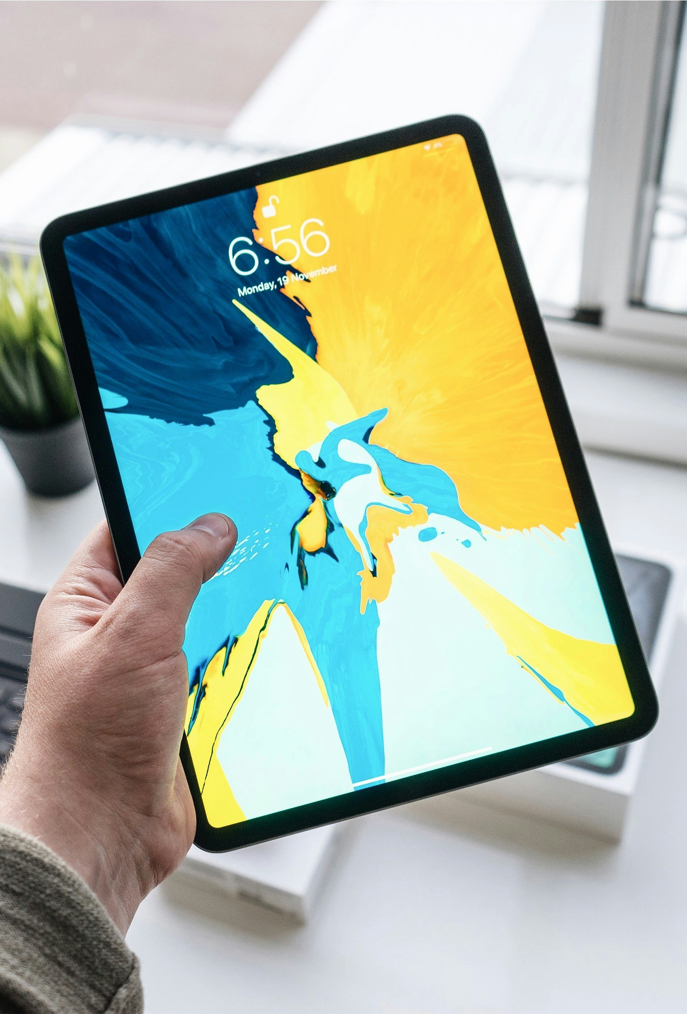
Additional Information And Updates
ITP is reviewing unique Directions for Administration for remote testing
Secure testing on Chromebooks must be on managed Chromebooks – unmanaged Chromebooks cannot run TestNav for remote testing
Pearson is working on a patch to address a remote testing bug affecting iPads running on iPadOS 17 and 18 – on second or subsequent TestNav sign ins, the student’s video feed will go black
  To fix, restart TestNav on the iPad
Today’s recorded webinar, PowerPoint, and responses from the Q&A will be made available for online schools

Slide 17

Questions? iowa-testing-programs@uiowa.edu
319-335-5408

